Slide 1
Software Product Line Architectures, Libraries, Frameworks, and Technologies for Web-based Applications
Presented by
Group - 19
Vidya Sudharshana (A20472468)
Sukanta Sharma (A20472623)
Rutul Mehta (A20476293)

Slide 2
Web - Applications
The applications which are communicate with HTTP is categorized as a web-application.
The client generally a web browser sends the HTTP request to the webserver, webserver and database server process the request, and gives appropriate output in the form of XML, JSON, or HTML.
Web server and Database server might be in different machines.

Slide 3
Software Product line Architecture (SPLA)
The Software Engineering Institute (SEI) characterizes the Product Line as "A Software Product Line (SPL) is a bunch of software concentrated frameworks that share a typical, oversaw set of highlights fulfilling the particular requirements of a specific market portion or mission and that are created from a typical arrangement of center resources in a recommended way.“
SPLE can be broken down into two core activities: domain engineering and application engineering.
Domain engineering, is the entire process of reusing domain knowledge in the production of new software systems. It is a key concept in systematic software reuse and product line engineering.
Application engineering is basically utilizing a subset of the common programming ancient artifacts.

Slide 4
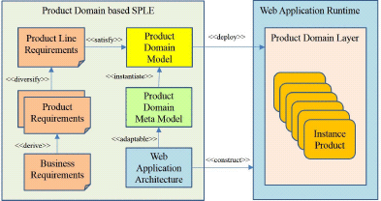
A Product Domain Model based SPL Engineering for Web Application
Engineering approach that defines a model called Product Domain Model expressing individual products and uses UML based meta-model with variability.
To execute transaction logic, defines an application architecture of adopting Dependency Injection.
Effective for web application having logics of diversity of products.

Slide 5
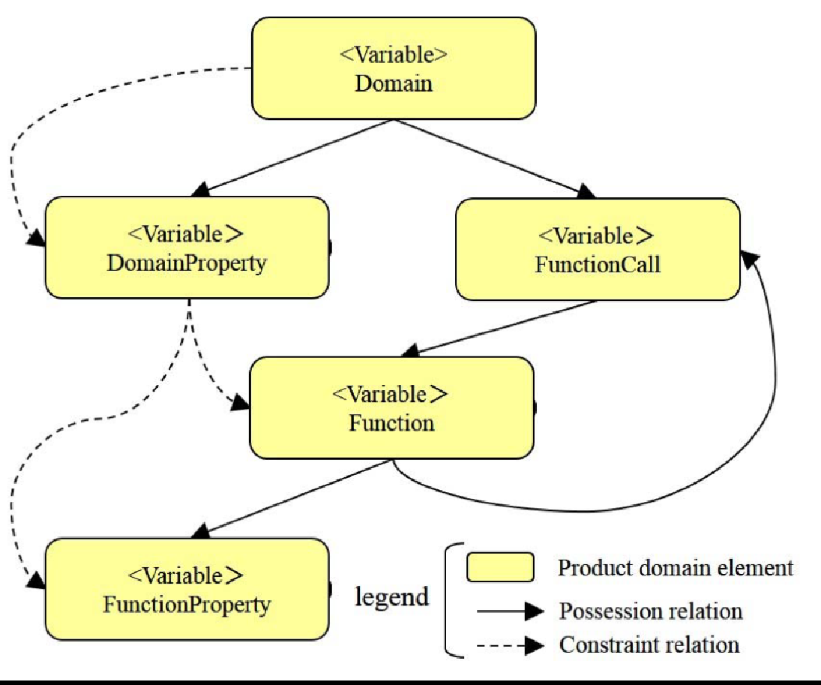
Product Domain Meta-Model
A domain can have multiple product line up but the underlying basic domain property, domain functions remain same, and they can be reused.
A characteristic of the product domain meta-model is easily enabled to add product newly by definition updates for variants of Domain Property, Function and Function Call.
For adding product, reusable of Function is enabled without influence on the existing products.

Slide 6
Product Domain Meta-Model (Benefits, Limitations, Applications)
Benefits:
- Dependency Injection
- Easy
- Effective for variety of products with different logics
Limitations:
- Incomplete traceability in lifecycle.
Applications:
- Banking products (Specially with complex logic)

Slide 7
Dependency Injection (DI)
Dependency injection (DI) is a technology for reducing inter-component dependency in the application architecture with supporting application runtime.
DI enables loosely coupled components, which are thereby highly reusable.
The idea of dependency injection is to move the code for instantiating sub-components from the program of a component to a component of framework

Slide 8
Koriandol Product Line Architecture for Web Applications
A component-based system that has explicit variability management built into the components in a defined way.
Components has built in mechanisms for variability determination which is the key factor in Koriandol method when compared to traditional component-based approach.
Component are selected from a in house library or marketplace and assemble them in a prescribed manner.
Commonalities and variable features are defined using FODA method.
Koriandol is a PLA designed to develop, deploy and maintain web application families

Slide 9
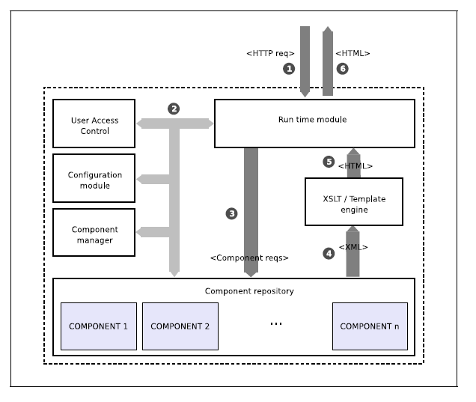
Koriandol System
Core Units in a Koriandol System
Management and Configuration module
Run time environment
Presentation Engine
A simplified schema is depicted in the figure.
Controlled flow is triggered by client(1), Run time module validates the user privileges(2), Page functionality is retrieved through component request(3), Method returns XML code(4), generating HTML code(5), segments put together and returned(6) to the user.

Slide 10
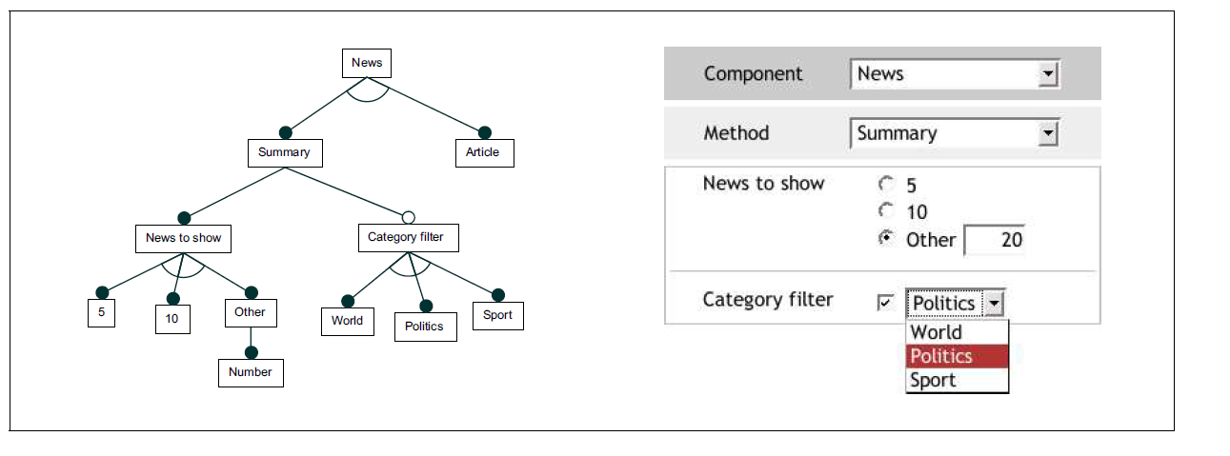
Illustration of Variability Handling Mechanism
In the featured diagram of simple news component as depicted in the figure, Variability is recognizable at different abstraction levels.
In news component it encompasses two methods: Summary and Article which displays a list of news and content, respectively.
They are represented as sub features of component. Summary has number of news items and category as sub features.

Slide 11
Web Application Technologies
To understand this term in a better manner, let’s break it down into two pieces: ‘web’ and ‘technology’.
Web means webpages, documents, and any other resources identified and located with the help of their URLs. These collectively form we also refer to as the World Wide Web.
Technologies which are core to the functioning of the World Wide Web.

Slide 12
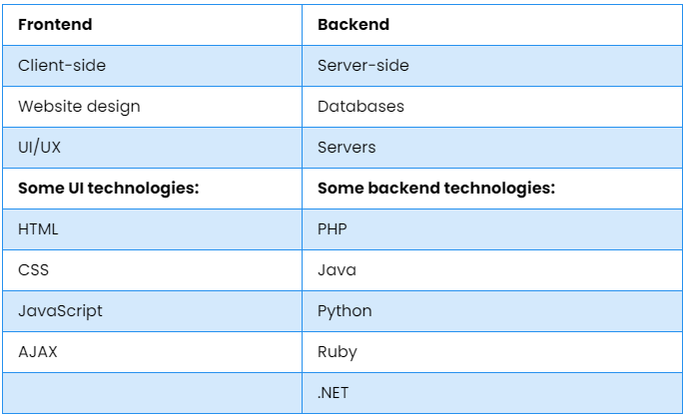
Front-End and Back-End Technologies
The process of making web development is mainly divided into two parts frontend development and backend development.
Frontend refers to all those parts of a website that a user can see on their screen and interact with. Backend refers to the exact opposite of that. It involves the hidden mechanisms that make a webpage function. A typical user is generally unaware of what goes on at the backend.

Slide 13
Databases
All the data that is exchanged on the web needs to be stored somewhere. For this purpose, most websites have their own databases associated with them.
Below is a list of some databases – some relational and others, non-relational – that are commonly used for web applications.
MySQL, SQL Server, Postgres, Oracle, MongoDB, Redis

Slide 14
Data Formats
Data can be travel in different formats over the internet.
It should be in such a format which receiver can easily decode and understand it.
XML
XML breaks down data into elements identified by various types of tags. However, with XML, you can invent your own tags to describe your data better. This data, upon reaching a web app or server, can be easily understood and analyzed.
JSON
JSON focuses more on quick and easy data exchange rather than detailed data definition and modelling. It also eliminates all the extra load that XML carries in the form of repetitive tags.

Slide 15
Web Application Frameworks
Web Application Framework or just "web structure" is a software framework that is intended to help the improvement of web applications including web services, web resources, and web APIs.
Now a days, various web application development frameworks are available like angular, react, ionic, Vue.js, Laravel, .Net core etc.
The choice of the framework is depending on the applications area. Complex and high budget web and mobile applications are preferred to develop in native frameworks rather than developing in the cross-platform application framework.

Slide 16
Emerging Cross-platform Web application Frameworks
In today’s highly disruptive and Darwinian mobile app development world, businesses wouldn’t risk missing their presence on either platform: Google Play Store or the Apple App Store.
Budget is usually an issue if businesses go for native apps. This is why cross-platform app development has emerged as the unrivaled choice of businesses that aim for a presence on Android as well as iOS.
There are various cross-platform frameworks are available like React, Ionic, Xamarin, Flutter etc.
But mostly companies are preferred to use Javascript based framework because these frameworks generate web as well as mobile application (Android and IOS).

Slide 17
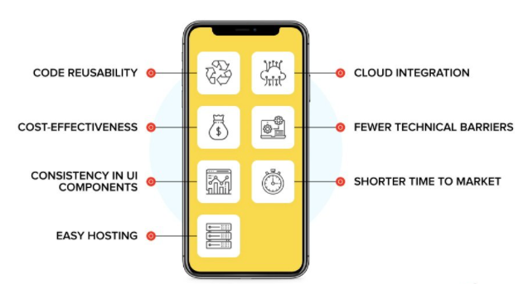
Advantage and disadvantage of the Cross-platform framework
Disadvantages:
- Inconsistent communication between the native and non-native components of gadgets.
- Performance-related glitches can lead to poor user experience.
- Security concerns
Advantages:

Slide 18
Native V/s Cross-platform frameworks
Parameter | Native Apps | Cross-platform apps
Cost | High Cost of Development | Relatively low cost of development
Code Usability | Works for a single platform | Single code can be used on multiple platform, for an easy portability
Device Access | Platform SDK ensures access to device’s API without any hindrance. | No assured access to all device APIs
UI Consistency | Consistency with the UI components of the device | Limited consistency with the UI components of the device
Performance | Seamless performance, given the app is developed for the device OS | High on performance, but lags and hardware compatibility issues are not uncommon .

Slide 19
Conclusion
Which SPL (Software product line) approach is better as it entirely depends on the requirement of our web- application.
But one thing is clear that we should follow the SPL where we can reuse the artifacts as much as possible which will eventually help in software development process.

Slide 20
Thank You

